Slide 1
Alzheimer Pre-Diagnosis iOS App
Proposal
Sushil Cherian & Jithin Varghese

Slide 2
Solution & Research Question
Can building pre- diagnosis iOS app for Alzheimer will improve accessibility and efficiency?
Alzheimer's pre-diagnosed app improves accessibility and efficiency
Handy and take up the test anywhere anytime
This will be useful for the family member as well as the care takers to know the severity
App can be used for healthier persons who are doubting on the Alzheimer can also take up the test

Slide 3
MEASURABLE ORGANIZATIONAL VALUE(MOV)
Social impact
Economic impact
Initial screening can be done privately

Slide 4
SCOPE
Scope is limited to develop an Alzheimer Pre-Diagnosis Mobile App which can be used by a healthier person or a care taker to a patient based on the score the app will suggest he has Alzheimer traits or not.

Slide 5
AIM & OBJECTIVES
AIM:
Alzheimer Screening based on the questions and its score for Pre-diagnosis
OBJECTIVES:
Design, Develop, Test and Publish an interactive iOS application with database on SQL Server
Knowing the severity of the Alzheimer
Stake holders:
Healthier persons and Care takers to patients
Data Analysts, Developers, Family members

Slide 6
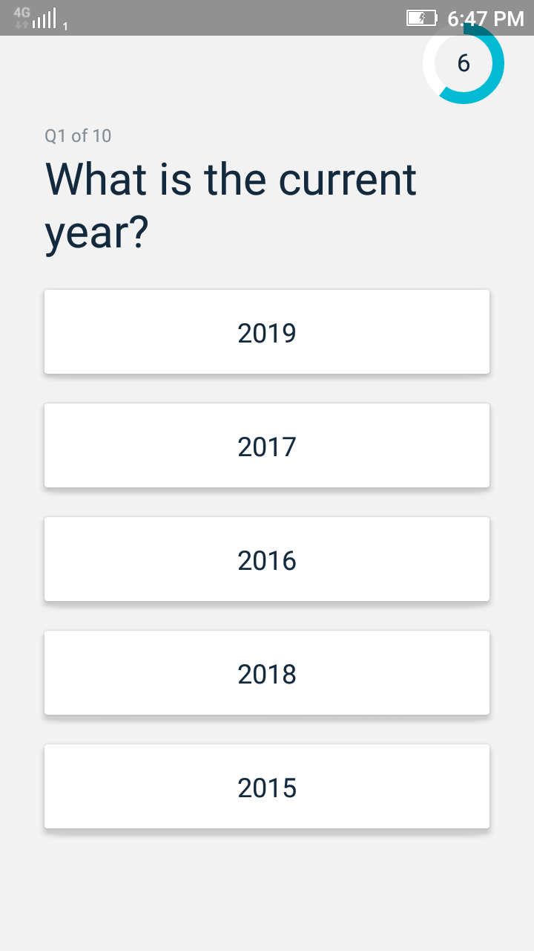
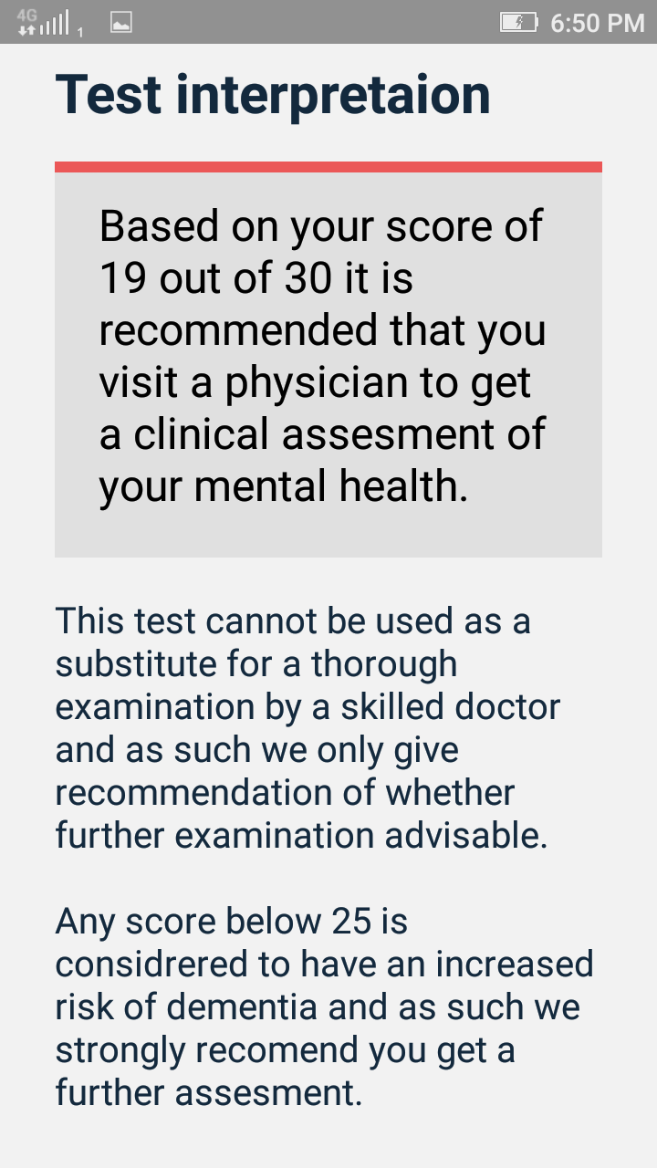
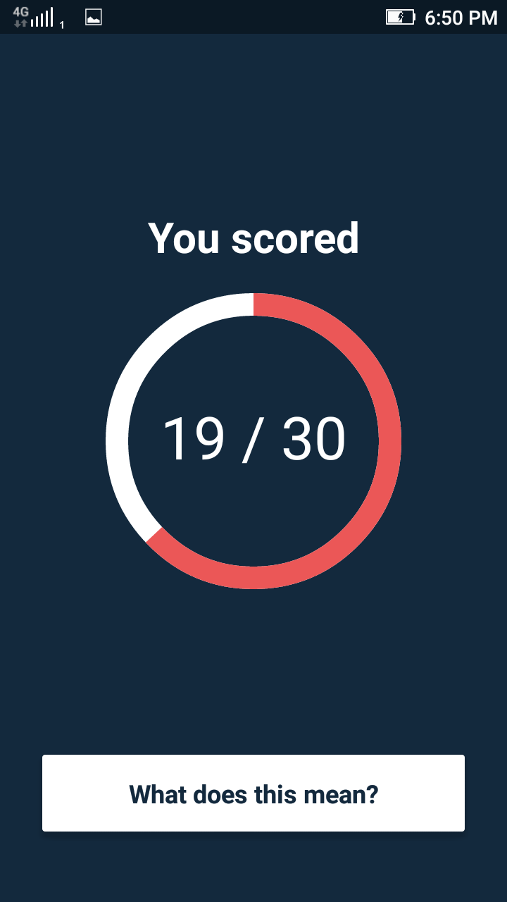
Existing Applications
Dementia Alzheimer’s Memory Diagnosis Test: MMSE

Slide 7
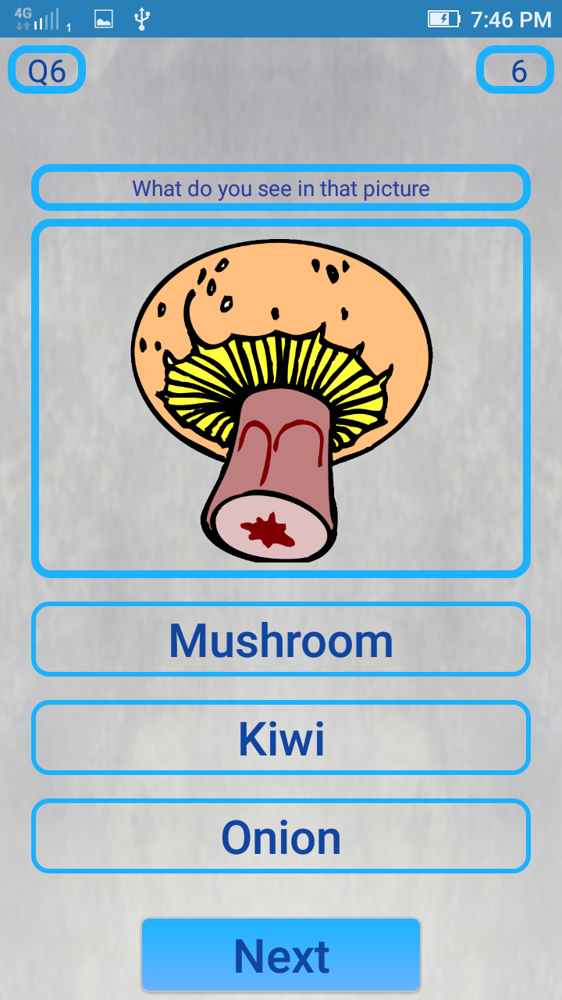
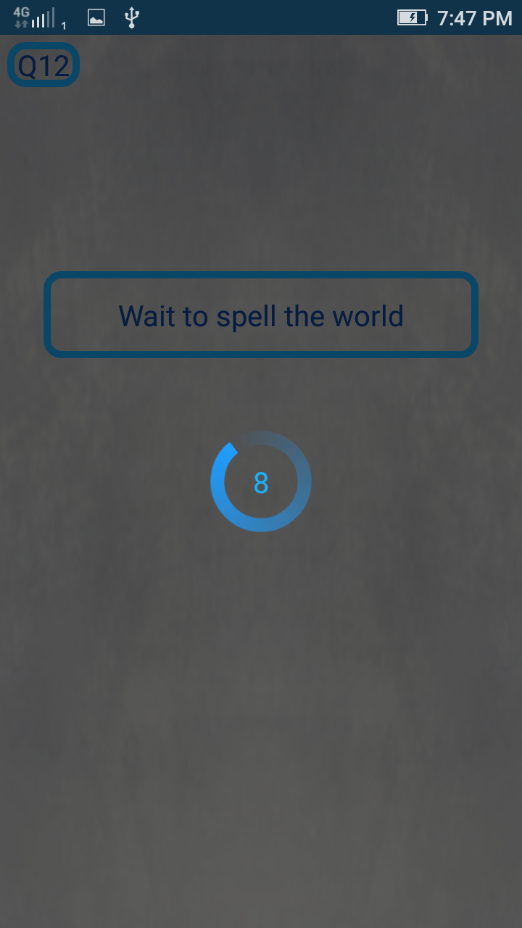
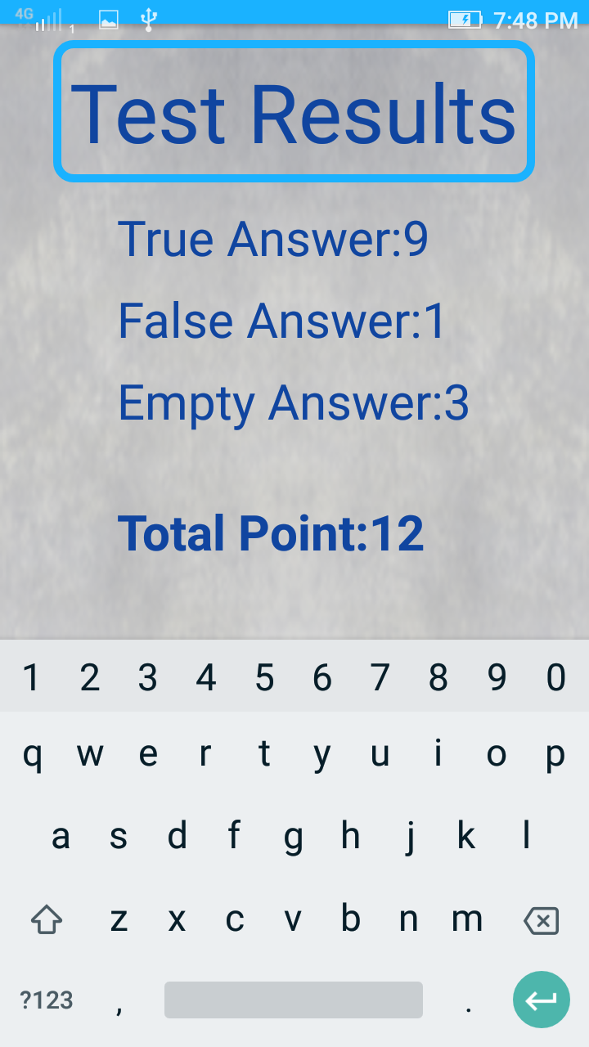
Mini Mental State App

Slide 8
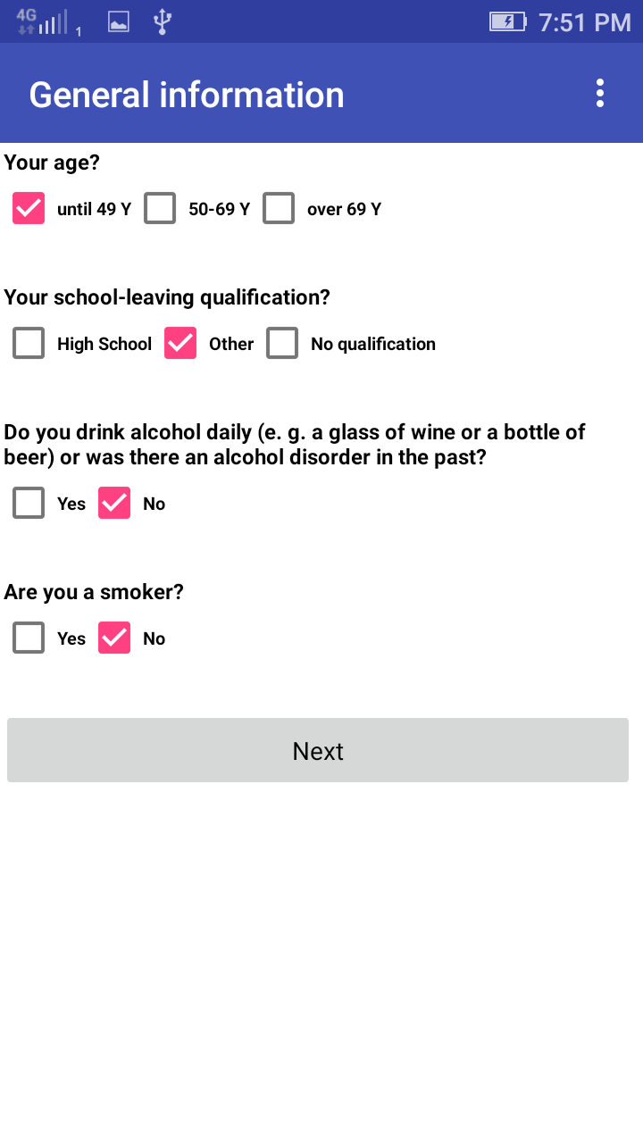
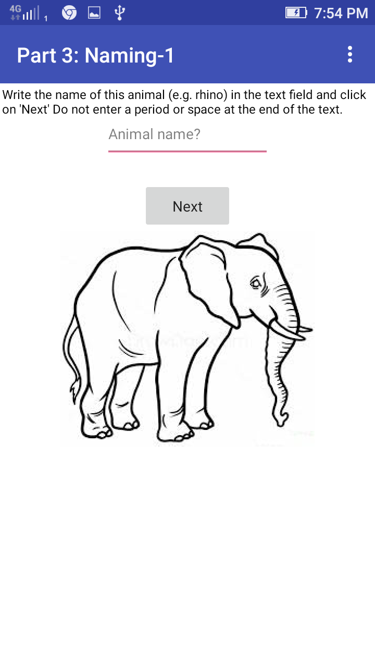
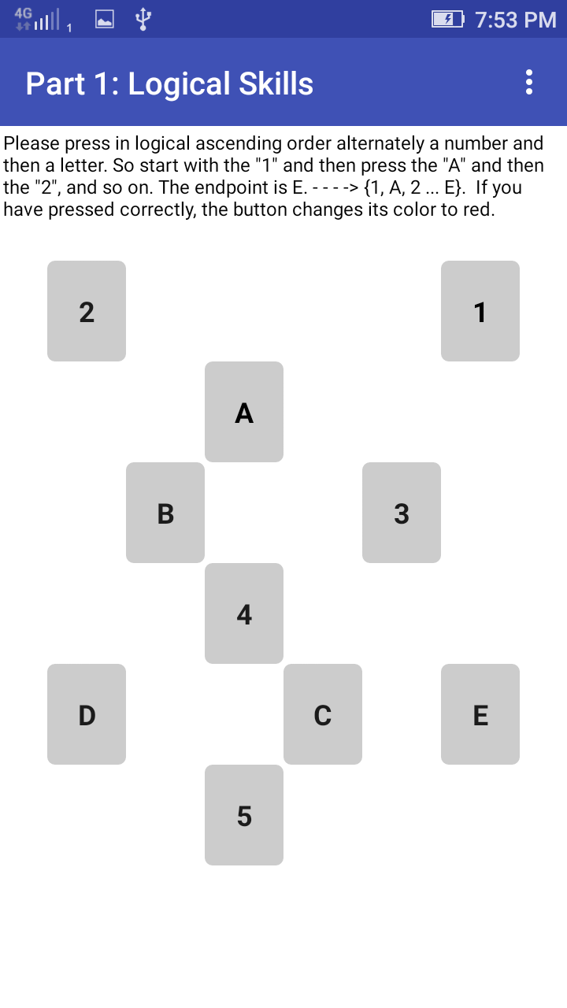
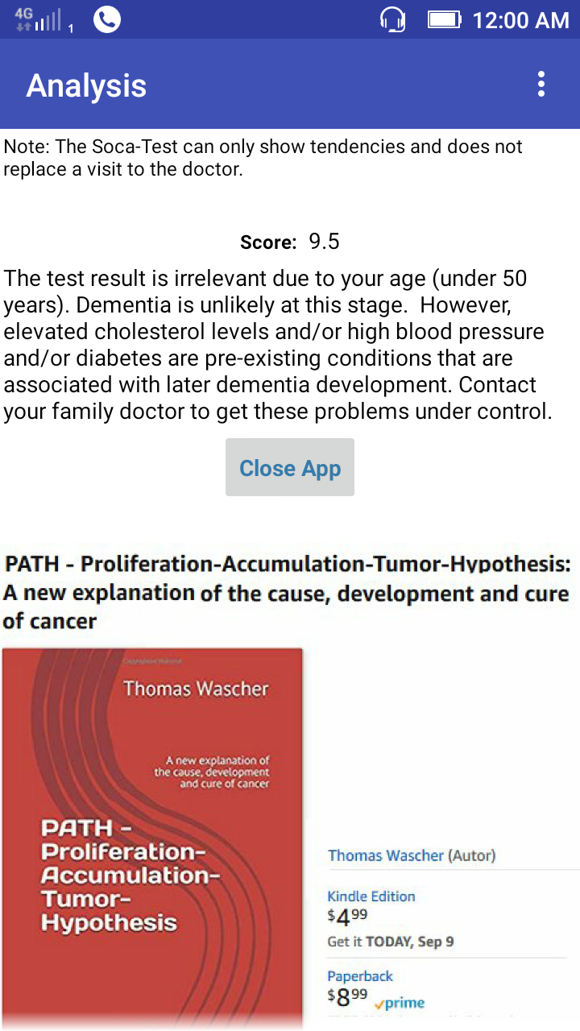
SOCA Dementia Testing App

Slide 9
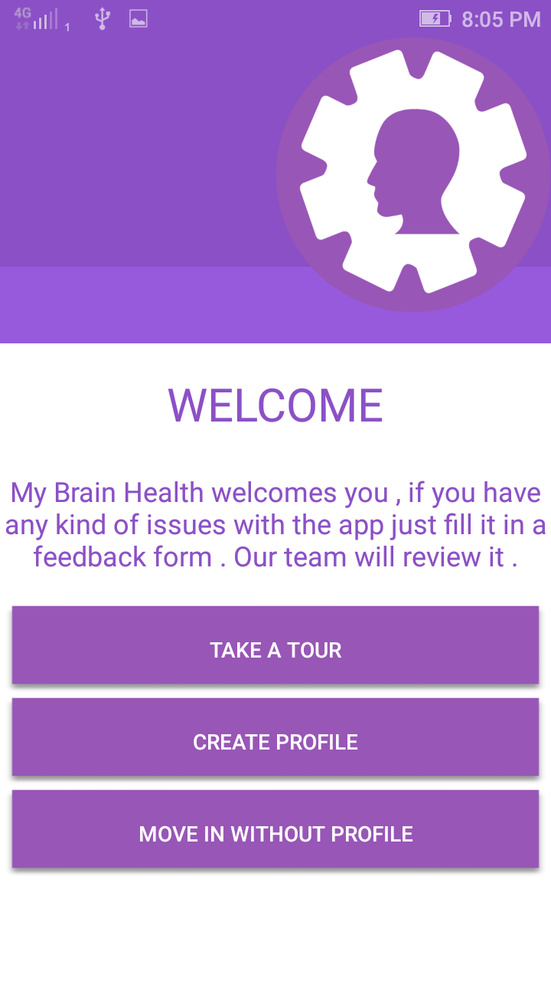
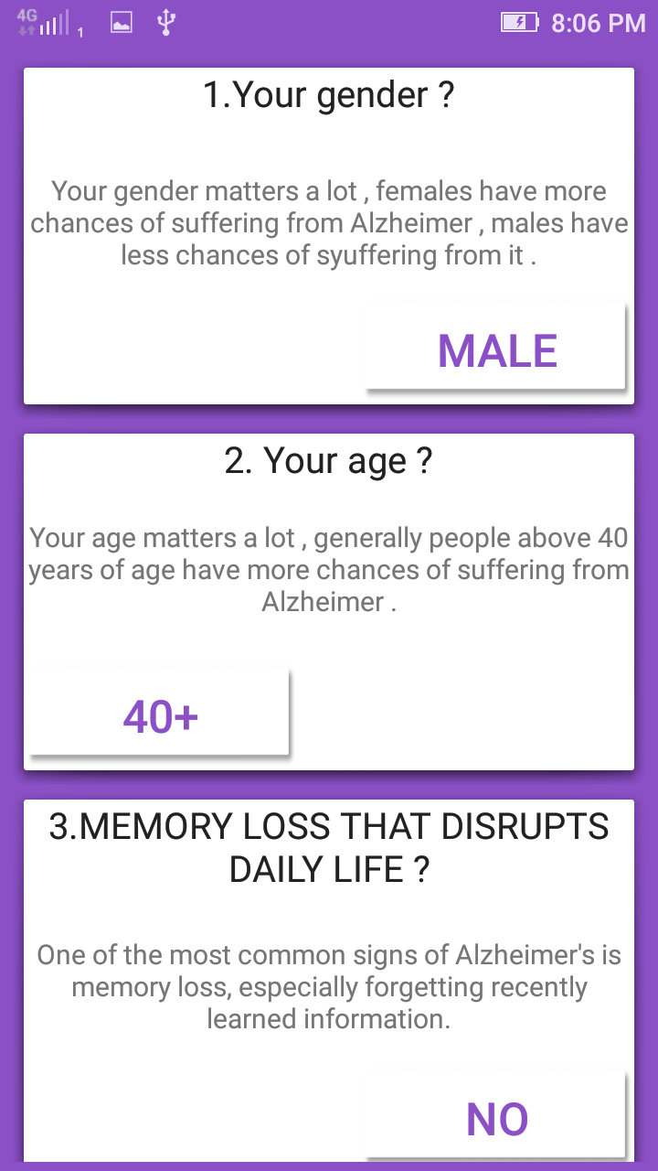
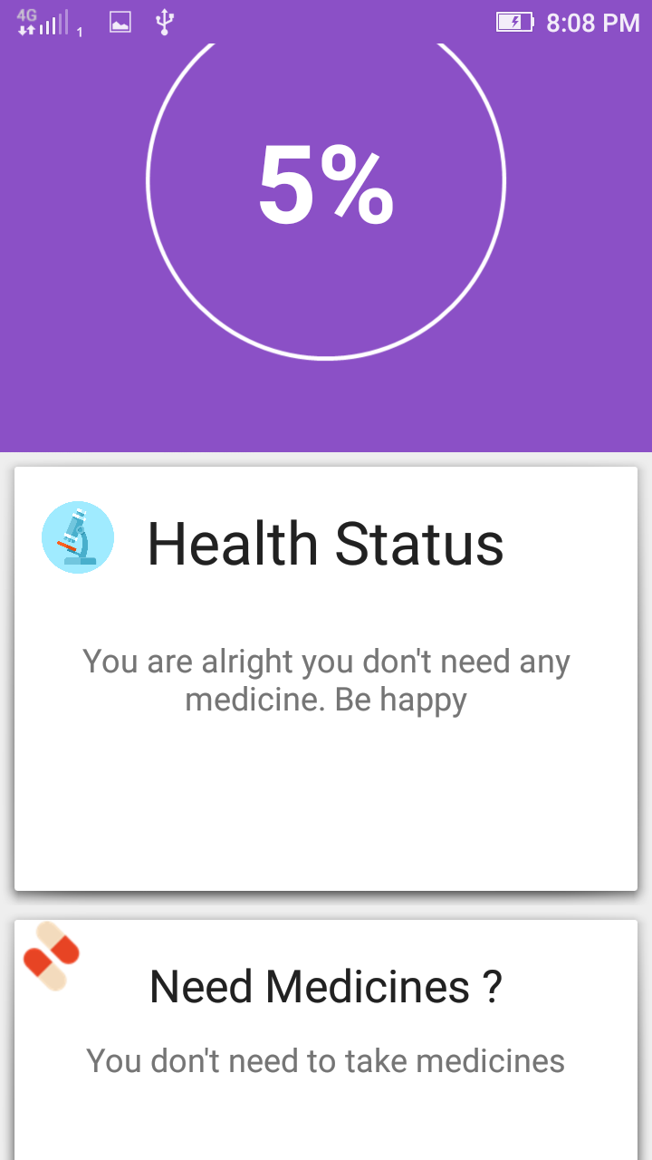
My Brain

Slide 10
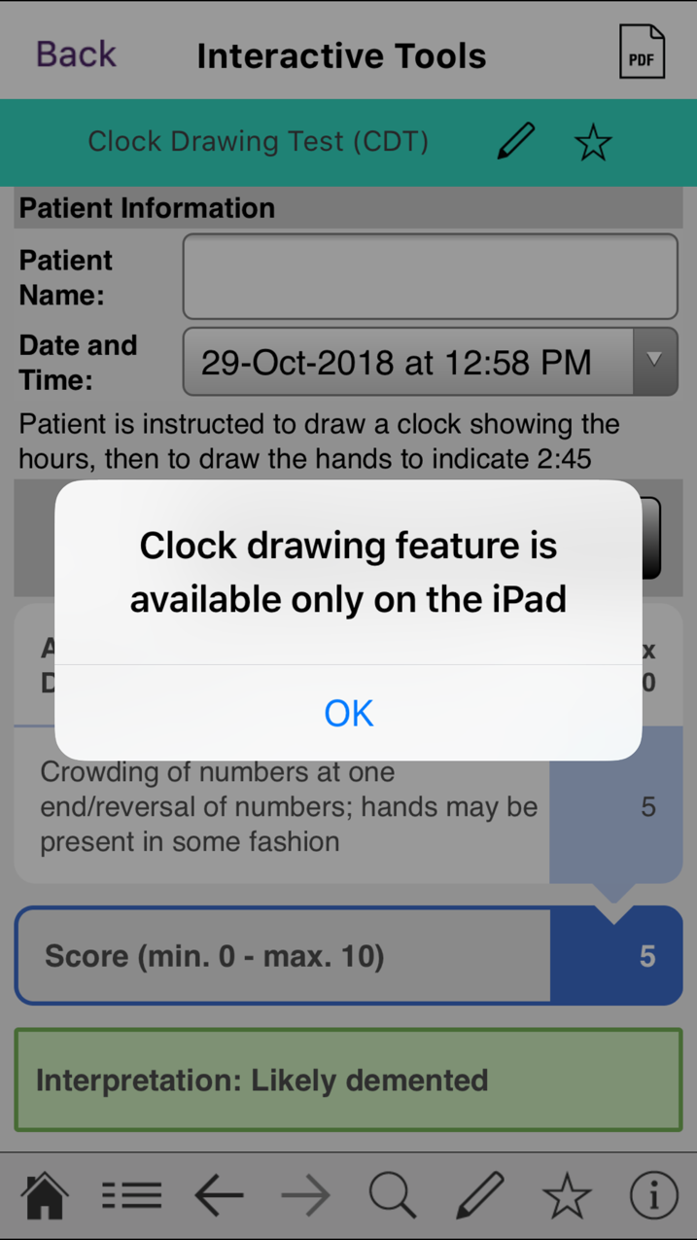
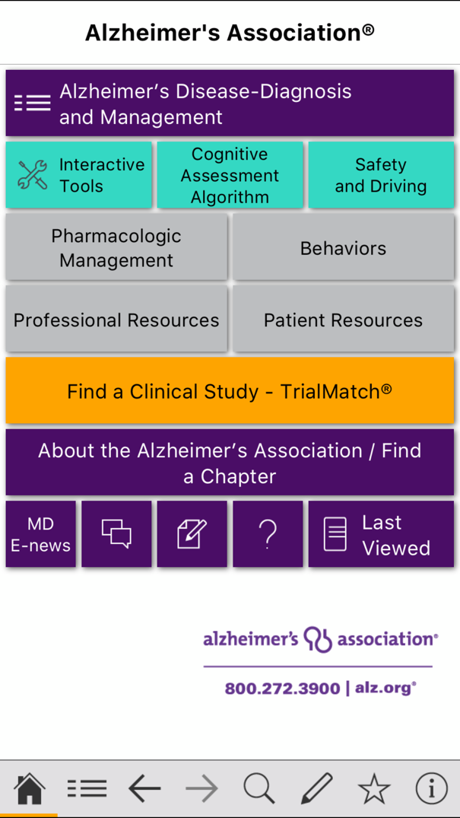
Alzheimer’s Disease Pocket card

Slide 11
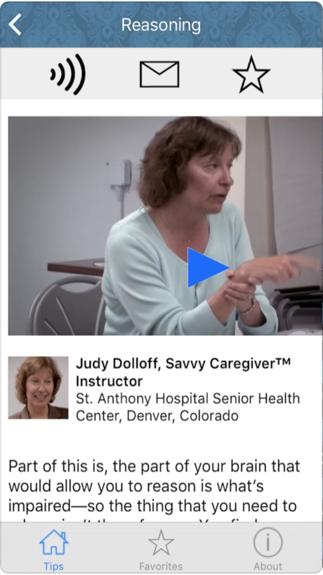
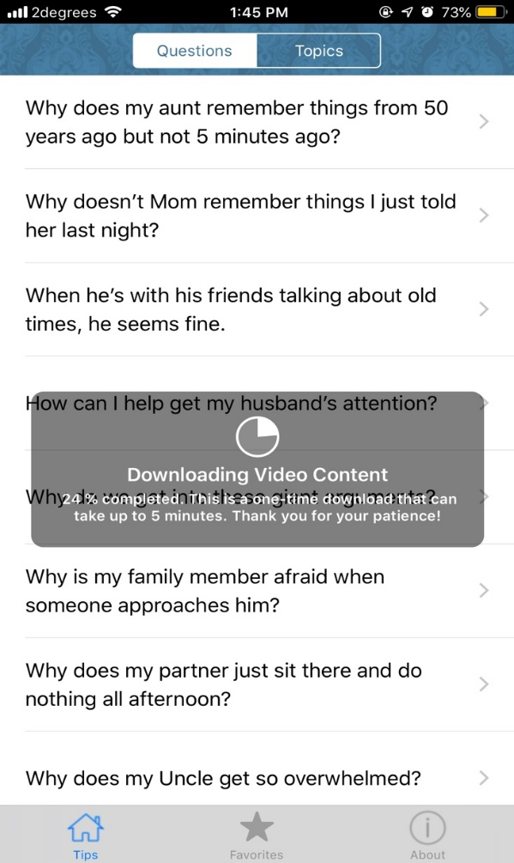
Alzheimer's and Dementia Tips for Families

Slide 12
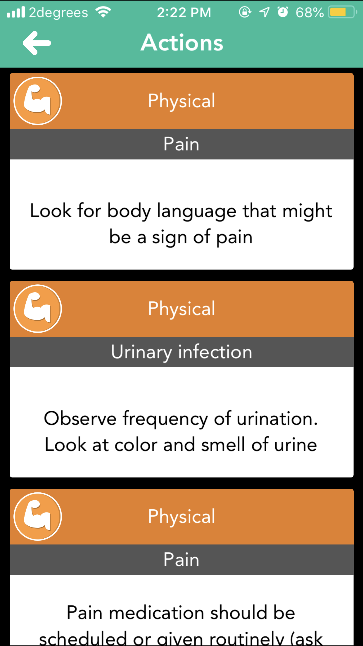
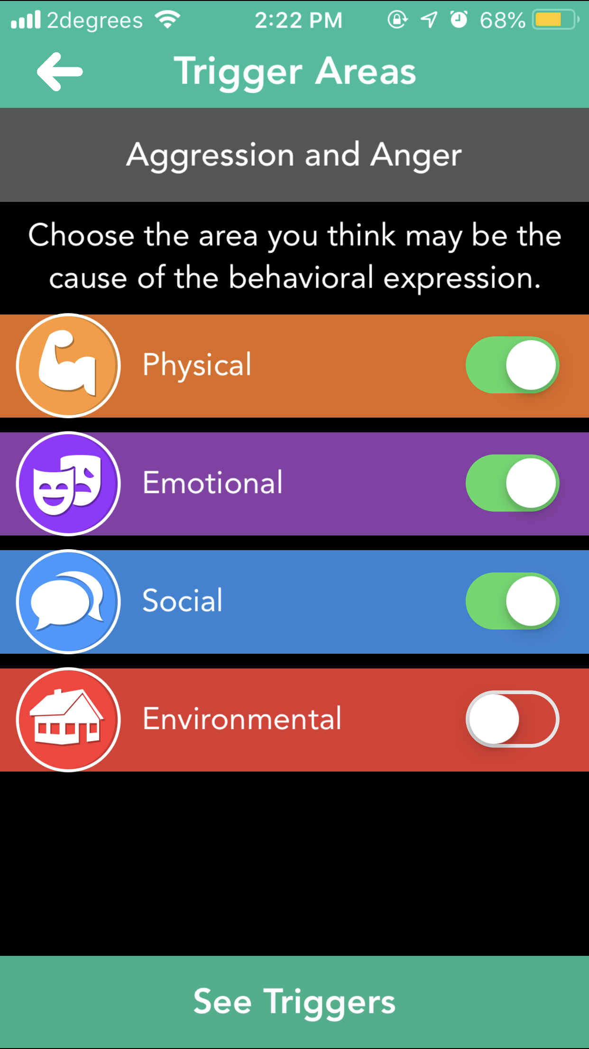
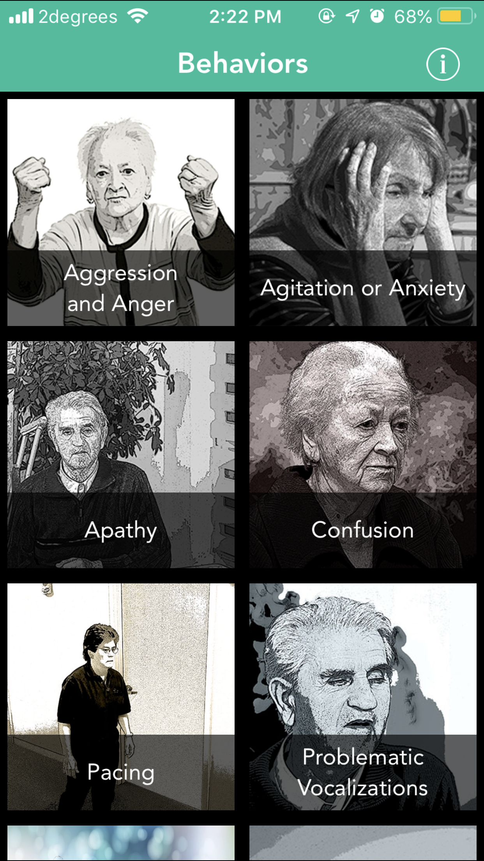
DementiAssist

Slide 13
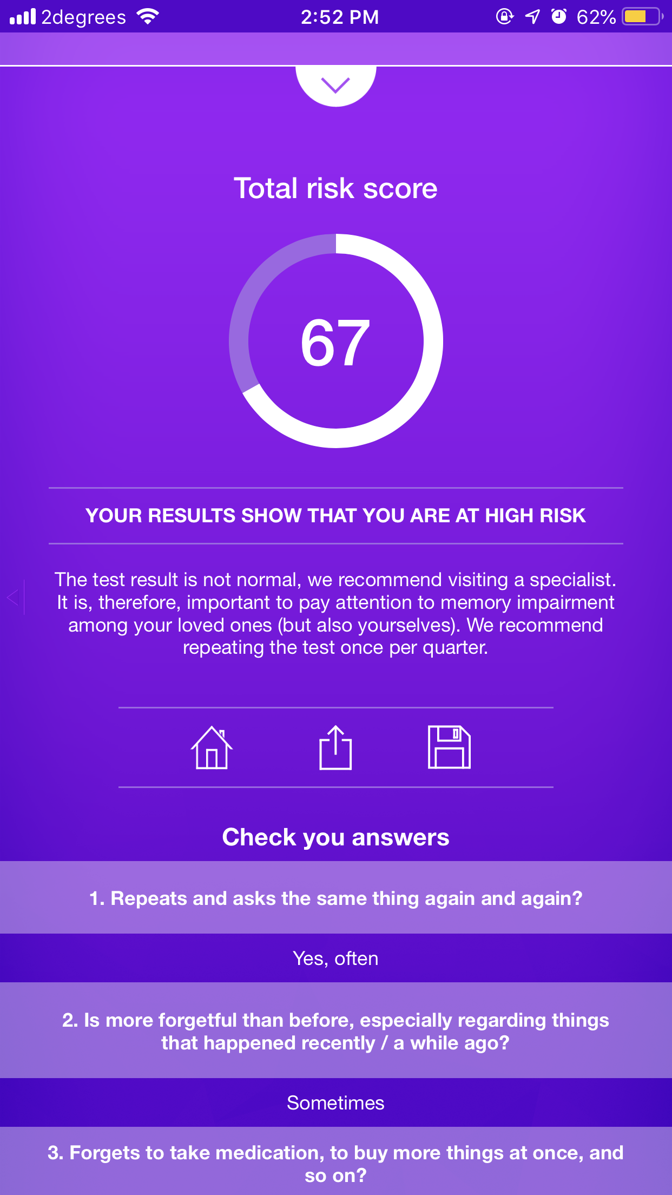
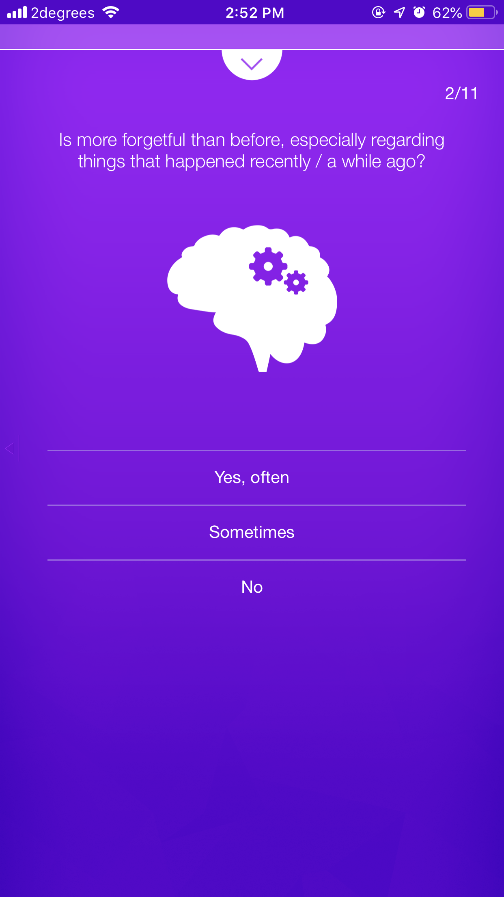
Dementia Test - risk calculator of dementia

Slide 14
Existing Applications Benefits and Faults
Pros
Most of the apps are based on MMSE
Static Questions
Audio and Visual
Cons
Some iOS apps required professional assistance
Some features are device depended
Some app entire contents are downloaded into the phone which cause device performance issues

Slide 15
Add Values
Based on DSM-5 standard
Free application

Slide 16
Features of our proposed app
User friendly Interface
Dynamic Questions
DSM-5 standard questions
Audio and visual interface

Slide 17
SOFTWARE TECHNOLOGIES AND METHODOLOGY
A software methodology is kind of framework that’s is used for software development which helps to do the developing in structure, plan and control the process of developing (Professionals, n.d.).
We have decided to choose Rapid Application Development (RAD), is a form an agile software development, which works on user feedback and strict planning and freezing the requirements.

Slide 18
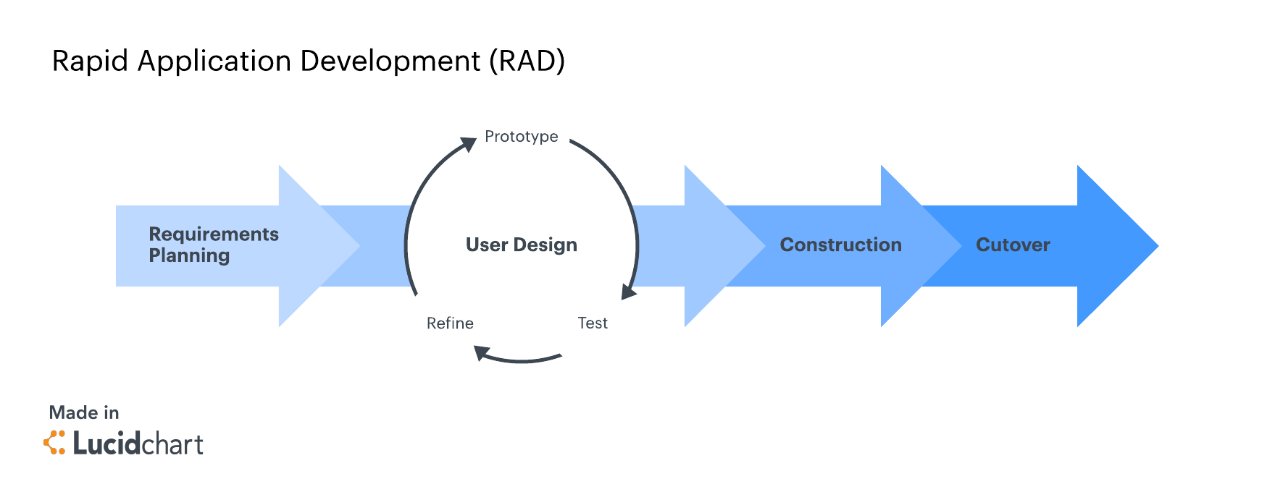
Rapid Application Methodology Phases (Team, 2018).

Slide 19
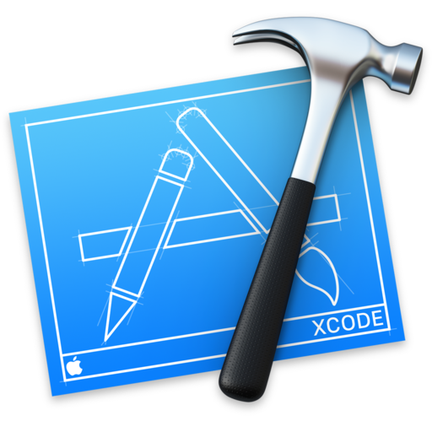




Resources

Slide 20
Project Risks
Time Constraints
Lack of Communication
Hardware Failure
Lack of Experience

Slide 21
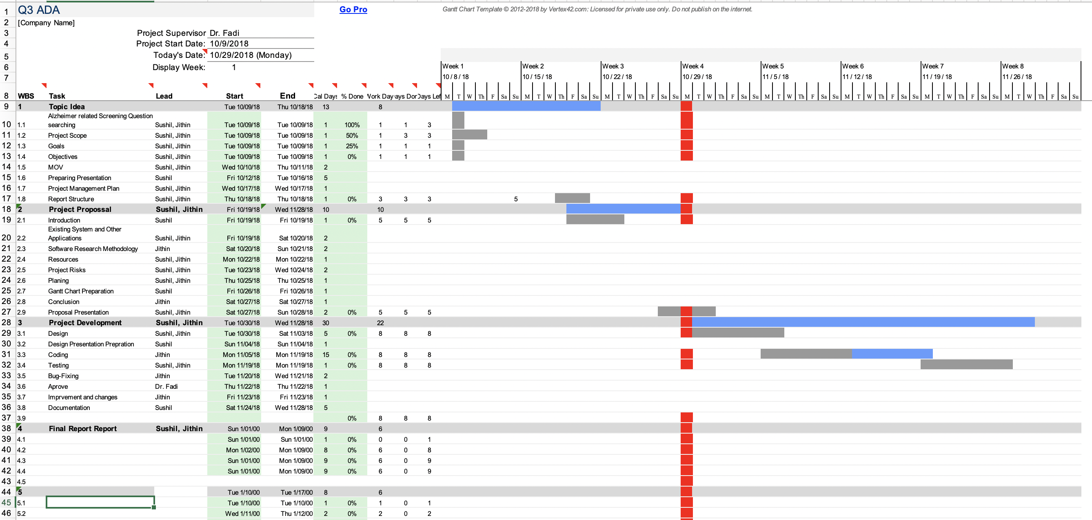
Gantt Chart

Slide 22
THANK YOU

